Slide 1
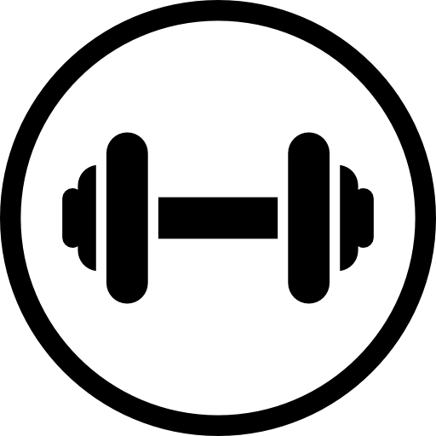
Optimal Pre-Workout Drink and Dosage
By Jeremy Shiu, Luke Shen, Kai Zheng, and Derek Nakagawa

Slide 2
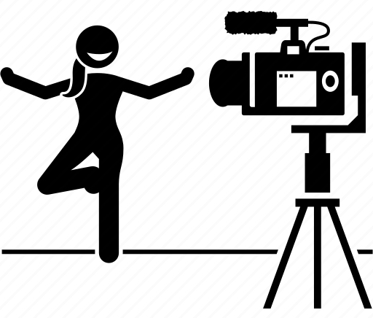
Research Question & Motivation
Many companies and “fitness influencers” have many different methods which they claim can improve your athletic performance.
How accurate are they? Who to trust?
Some of these methods include runners consuming a lot of carbohydrates leading up to a big run or gym bros taking pre-workout loaded with caffeine.
We Want To Know:
Does consuming certain drinks before you exercise have a significant impact on your performance?

Slide 3
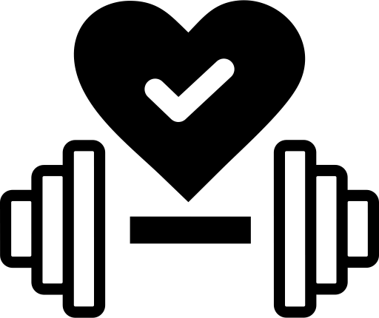
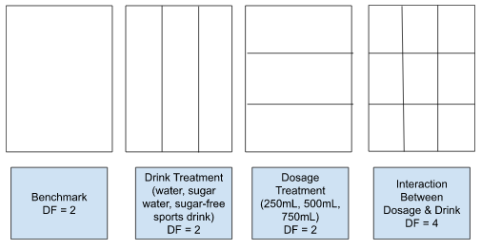
Experiment Design
Experimental Design: two factor ANOVA with interaction.
Total of 9 Treatment Groups
Treatment 1: (Drinks)
Water
Sugar-Free Sports Drink
Sugar Water
Treatment 2: (Dosage)
250 mL
500 mL
750 mL
Response:
Percent change in bicep curl repetitions

Slide 4

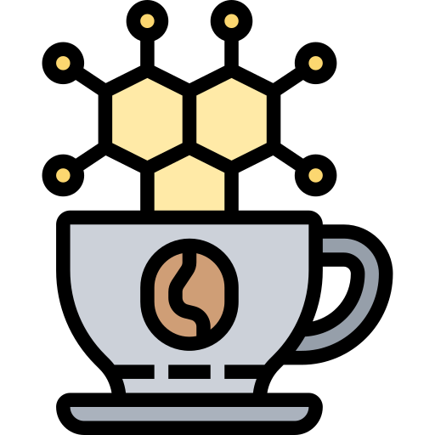
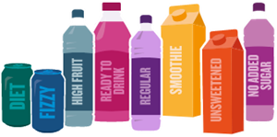
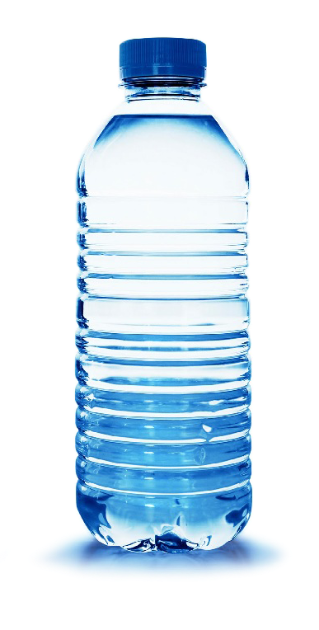
Literature Review
Ingesting caffeine produces a small, but noticeable and significant difference in muscular strength and overall athletic performance for both trained and untrained individuals. Consuming too much caffeine, however, does tend to produce negative side effects. [1]
Ingesting carbohydrates (sugar) in general is important for maximizing athletic performance and does produce a noticeable difference compared to not ingesting sugar shortly before exercising. [2]
Being hydrated (consuming liquid shortly before exercise) does improve muscle endurance but is more noticeable in endurance sports rather than short bursts of exercise. [3]

Slide 5
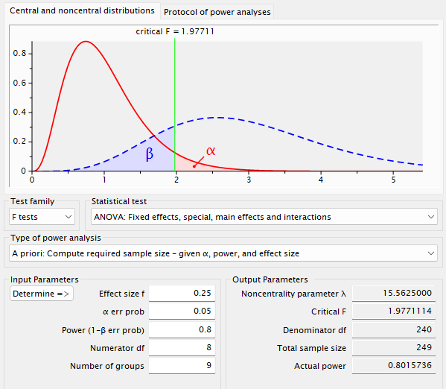
Sample Size Determination
Desired Power: 80%
Total of 9 Treatment Groups
Effect Size = 0.25
Significance Level: 0.05
Total of 252 participants needed
~28 Participants per Treatment

Slide 6
Sampling Methodology
Participants
We chose to sample specifically men in the age bracket of 18-30
Significant effect of age and gender on muscular strength [4]
Minimize effect of individual variation in raw strength with percent difference as the response variable.
Methodology
Take baseline measurement, wait at least a day, and then apply treatment and measure again.
NOT A RANDOM SAMPLE from the population as that was logistically impossible.
We did pseudo-randomly assign the samples into groups and then pseudo-randomly assigned a treatment to each group.

Slide 7
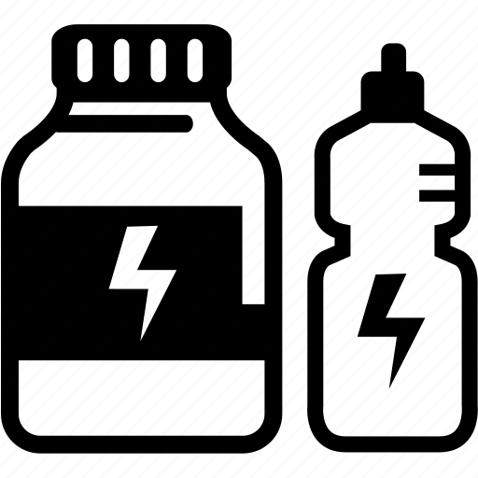
Response Variable
X1 = Baseline Test (drink nothing)
X2 = New Value (treatment drink)
Response Variable = (X2-X1)/(X1)
Need to compare relative to their own baseline performance!
For treatment drink (X2), we wait 30 minutes after finishing the drink before testing strength
Takes ~30 minutes for both caffeine & sugar to make it into the bloodstream
(also similar to amount of time it takes to drive to gym)

Slide 8
ANOVA Table
 | DF | Sum Squares | Mean Squares | F-Value | P-Value
Dosage (mL) | 2 | 0.0047 | 0.002347 | 0.294 | 0.7458
Drink | 2 | 0.0207 | 0.010370 | 1.298 | 0.2750
Dosage:Drink | 4 | 0.0631 | 0.015786 | 1.975 | 0.0989
Residuals | 243 | 1.9419 | 0.007991

Slide 9
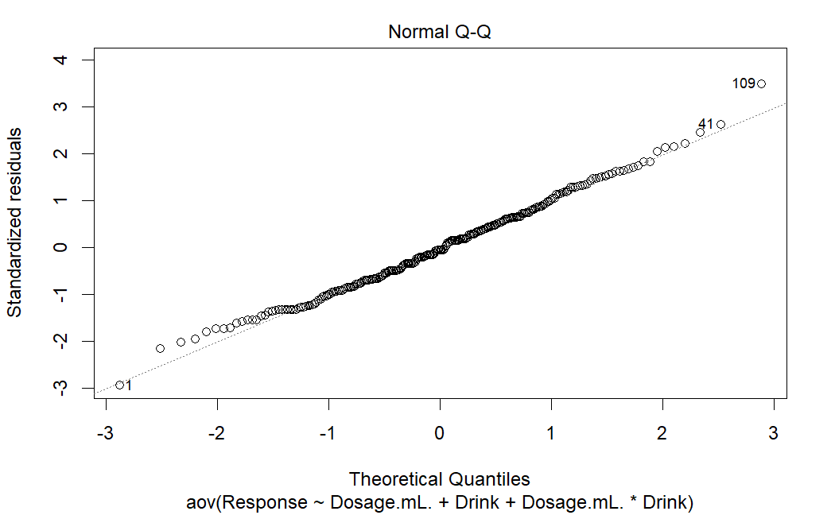
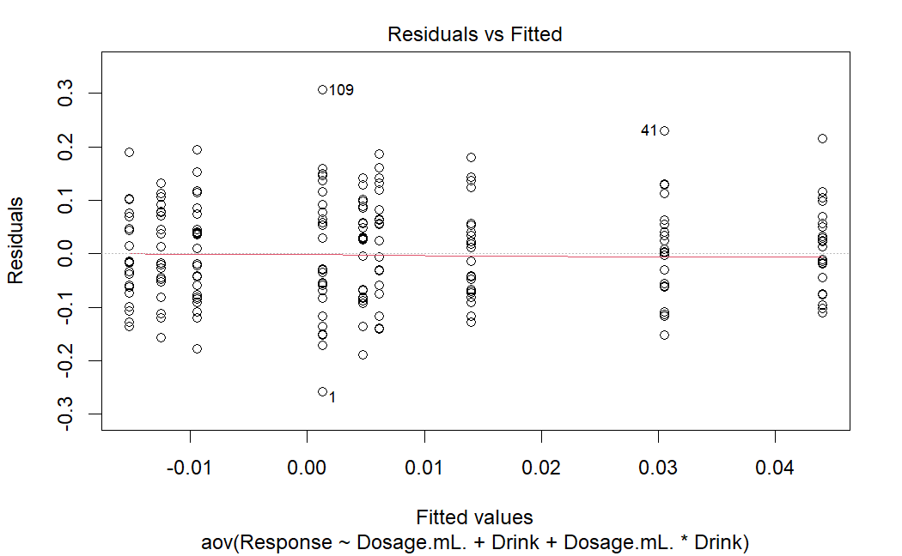
Normal Q-Q Plot
Residual vs. Fitted Plot

Slide 10
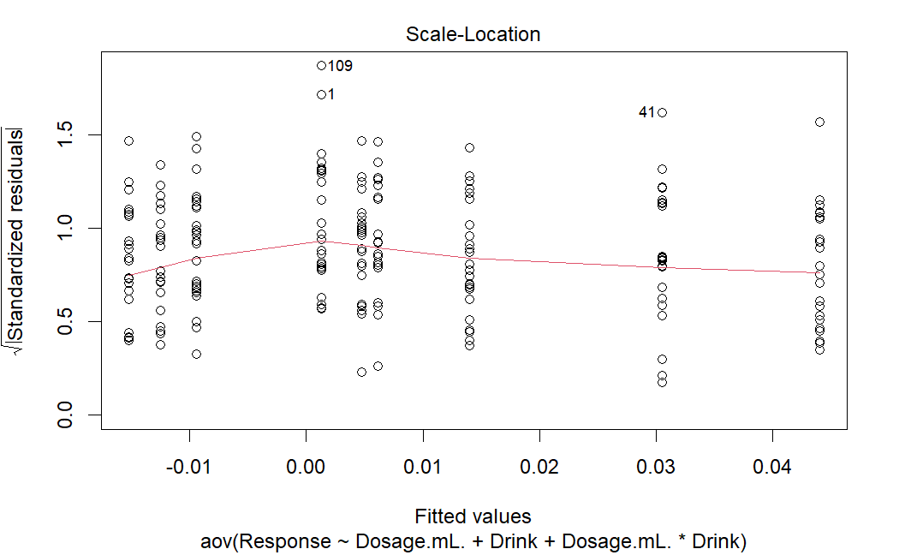
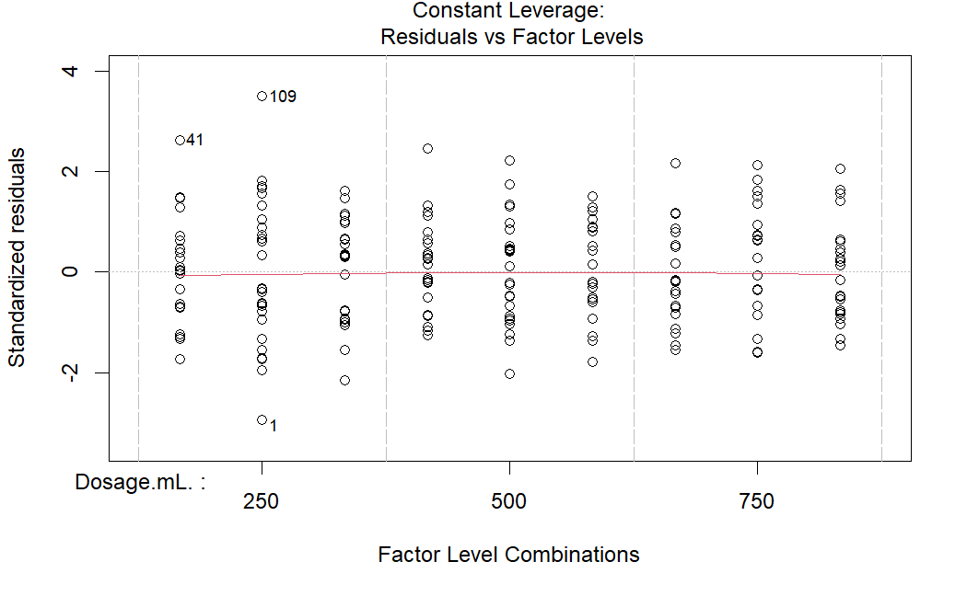
Scale-Location Plot
Constant Leverage Plot

Slide 11
Tukey Test
Dosage(mL) | diff | lwr | upr | p adj
500-250 | -0.004826190 | -0.03735409 | 0.02770171 | 0.9347685
750-250 | -0.010558333 | -0.04308623 | 0.02196957 | 0.7245535
750-500 | -0.005732143 | -0.03826004 | 0.02679576 | 0.9092478

Slide 12
Tukey Test
Drink | diff | lwr | upr | p adj
sugar water — sugar free energy drink | -0.004826190 | -0.03735409 | 0.02770171 | 0.9347685
water — sugar free energy drink | -0.010558333 | -0.04308623 | 0.02196957 | 0.7245535
water — sugar water | -0.005732143 | -0.03826004 | 0.02679576 | 0.9092478

Slide 13
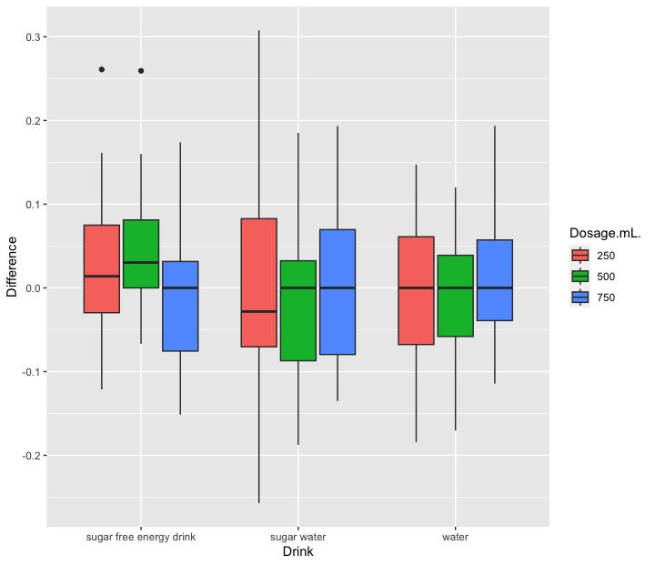
Boxplot

Slide 14
Conclusions!
No significant factors: Based on the data, both type of energy drinks and dosage of energy drink did not achieve significant p-values.
Unexpected result based on literature review - perhaps we should try a new exercise test next time.
On average, the sugar-free energy drink had the strongest positive effect on bicep curls (as expected), but it was not enough to reach statistical significance.
No significant interaction between factors: However, out of all of the F-tests, the p-value for dosage:drink interaction was closest to significant.
Diagnostic plots look great, so we can conclude that the model was valid.
Our data seems to fit the model based on graphs in previous slide, so it’s safe to make assumptions!

Slide 15
Future Research Questions
How do varying amounts of caffeine content within the same drink affect bicep strength?
How long should one wait after drinking an energy drink in order to see the maximum boost in athletic performance?
How do different drinks and/or dosages affect performance in exercises besides bicep curls (sprinting, long-distance running, maximum bench press, etc.)?
Are athletic performance improvements from energy drinks purely physiological, or is some of the effect attributable to psychological effects (placebo effect)?

Slide 16
References
Guest, Nanci S., et al. “International Society of Sports Nutrition Position Stand: Caffeine and Exercise Performance - Journal of the International Society of Sports Nutrition.” BioMed Central, 2 Jan. 2021, jissn.biomedcentral.com/articles/10.1186/s12970-020-00383-4.
Peinado, Ana B et al. “El azúcar y el ejercicio físico: su importancia en los deportistas” [Sugar and exercise: its importance in athletes]. Nutricion hospitalaria vol. 28 Suppl 4 (2013): 48-56. doi:10.3305/nh.2013.28.sup4.6796
Von Duvillard, Serge P et al. “Fluids and hydration in prolonged endurance performance.” Nutrition (Burbank, Los Angeles County, Calif.) vol. 20,7-8 (2004): 651-6. doi:10.1016/j.nut.2004.04.011
Guest, Nanci S., et al. “International Society of Sports Nutrition Position Stand: Caffeine and Exercise Performance - Journal of the International Society of Sports Nutrition.” BioMed Central, 2 Jan. 2021, jissn.biomedcentral.com/articles/10.1186/s12970-020-00383-4.

